Slide 1


Isn’t It Ionic?
Building hybrid mobile applications faster with the Ionic Framework
Matthew Ridley | @matt_ridley | matt@milkcan.io

Slide 2

Principal Sponsor
http://www.SkylineTechnologies.com
Thank our Principal Sponsor by tweeting and following @SkylineTweets
©2015 Milk Can LLC

Slide 3
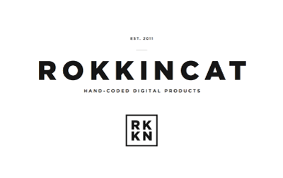







Gold Sponsors
Silver Sponsors
©2015 Milk Can LLC

Slide 4


August 8th – 10th 2016
Kalahari Resort, Wisconsin Dells
http://www.ThatConference.com
©2015 Milk Can LLC

Slide 5
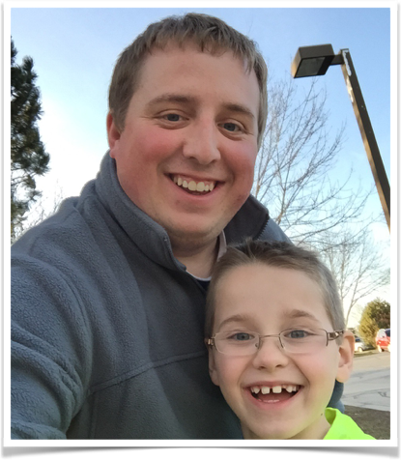
Who Is This Guy???
Matthew Ridley
@matt_ridley
Co-Owner of Milk Can LLC http://milkcan.io
Experience Writing Apps for:
Alliance Laundry Systems
Polaris
Foot Locker
… and more
©2015 Milk Can LLC

Slide 6
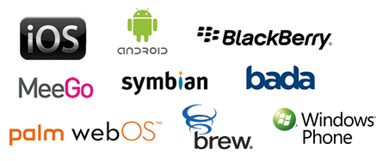
Going Native
PROs
CONs
Can utilize all of the OS and Hardware functionality
Usually better performance
Expensive
Requires large or multiple teams to support each platform
Virtually no shared code or assets
Costs increase per platform
OS Versions can cause headaches (even on iOS!)
©2015 Milk Can LLC

Slide 7
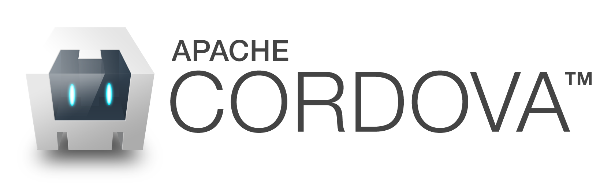

Going Hybrid (The Old Way)
PROs
CONs
Low cost point to add additional platforms
Shared Code
Does not require OS specific knowledge most of the time
Can be hard to access and use OS and Hardware features
Can appear sluggish (especially on older hardware)
Hard to Prevent the “Looks like a Website”
Non-Native look for one or more platforms
©2015 Milk Can LLC

Slide 8

And then there was Ionic… and it was good.
(Really Good)
©2015 Milk Can LLC

Slide 9
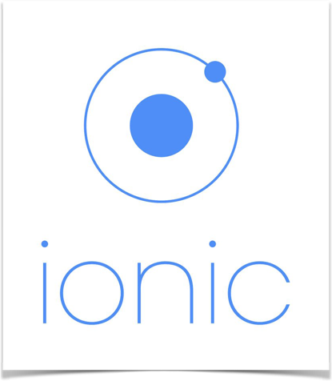
Meet Ionic
Mobile Hybrid SDK
Extends Cordova
1,000,000+ Apps Created Through Ionic-CLI
Release History
Alpha - Nov 2013
Beta - March 2014
Version 1.0 - May 2015
Currently on version 1.1
©2015 Milk Can LLC

Slide 10





How Does It Work?
©2015 Milk Can LLC

Slide 11
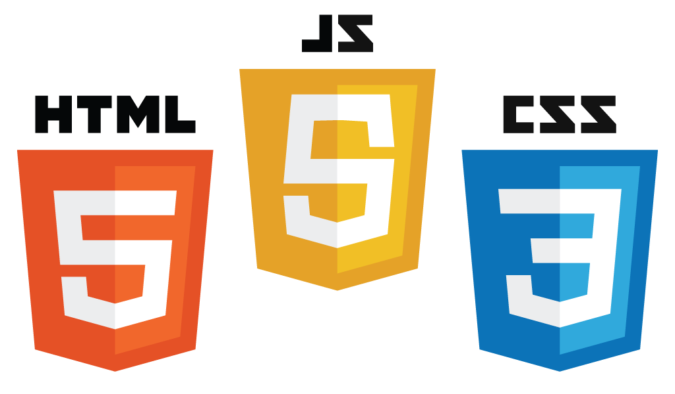
Use What You Know
20+ Years of Tools and Technology
Your favorite IDE, text editor and debugger tools
Share code with your website
Allows web-heavy development group resources to be used on mobile work
©2015 Milk Can LLC

Slide 12

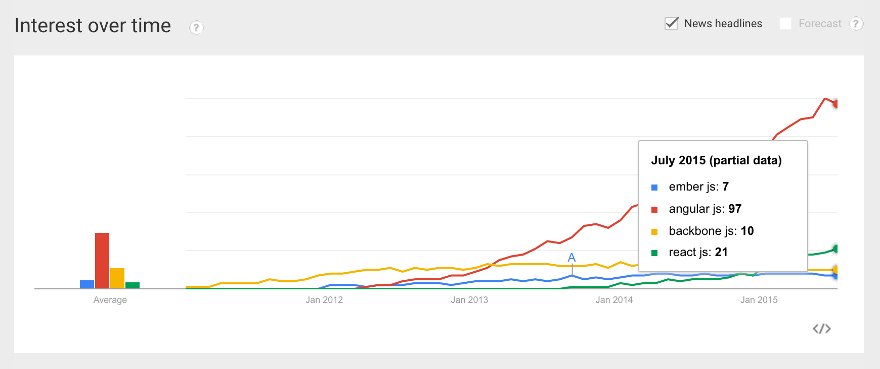
AngularJS!
Most popular JS framework
MVC
Unit Testing Ready
And More…
http://www.sitepoint.com/10-reasons-use-angularjs/
source: http://bit.ly/1H7lD3b
©2015 Milk Can LLC

Slide 13
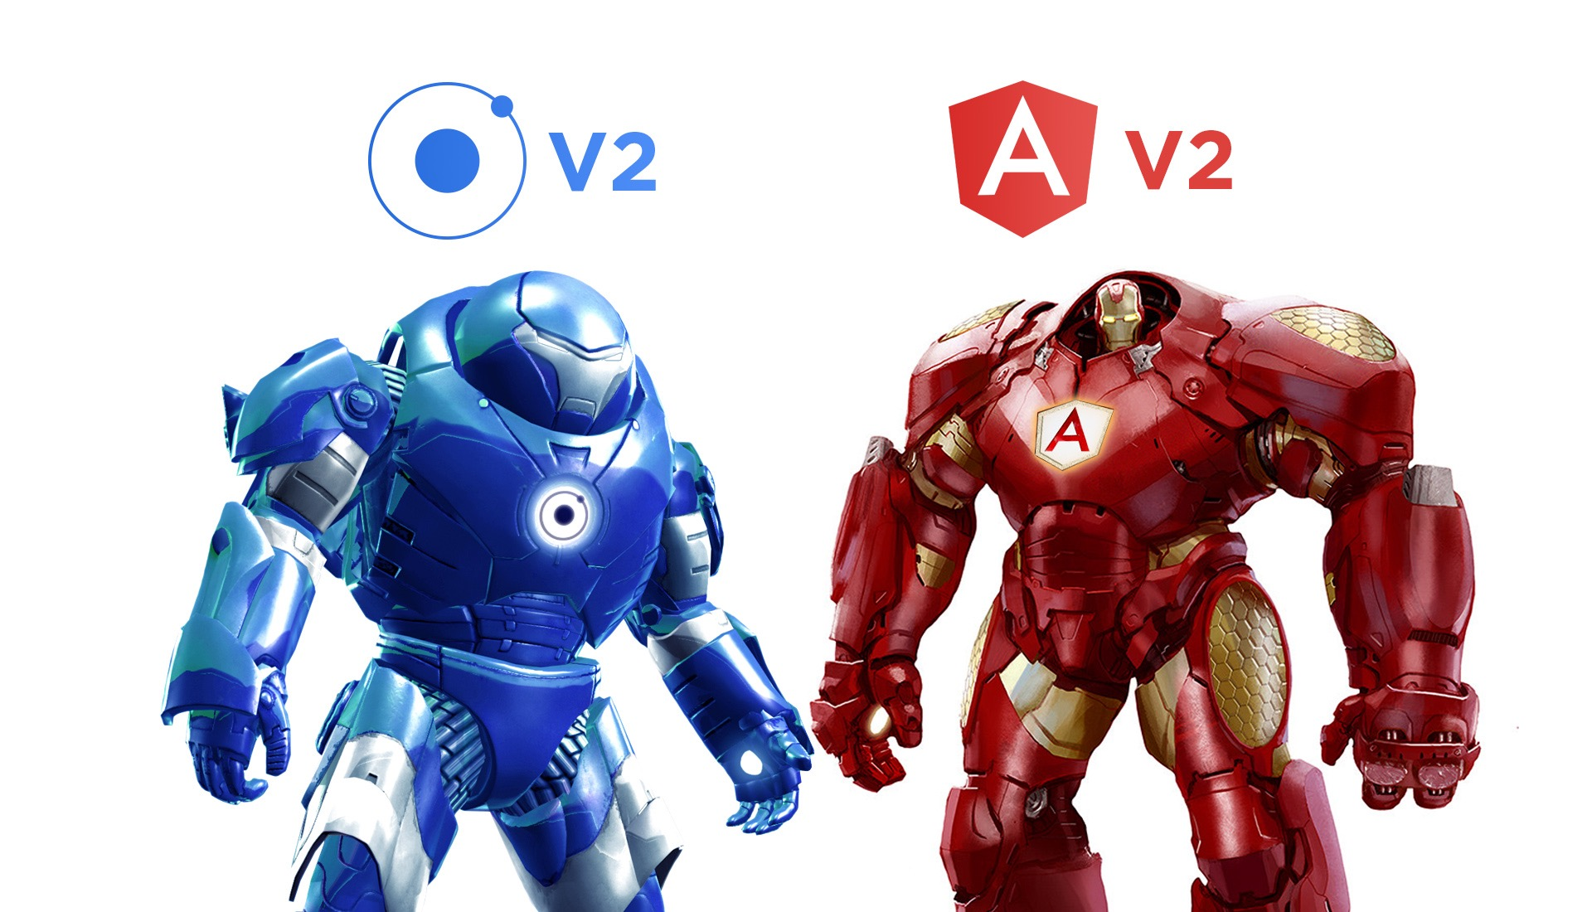
What About AngularJS 2.0???
Ionic v2.0 and Angular v2.0 will release the same day
Ionic Team is less than 6 hours behind Angular team releases
Public Alpha released Monday (October 19):
http://blog.ionic.io/announcing-ionic-2-0-alpha/
©2015 Milk Can LLC

Slide 14

SASS!!! (or SASS???)
Power Your CSS with Sass
Still can use Less or plain CSS3 if you want.
Next version of Bootstrap will be in Sass
©2015 Milk Can LLC

Slide 15
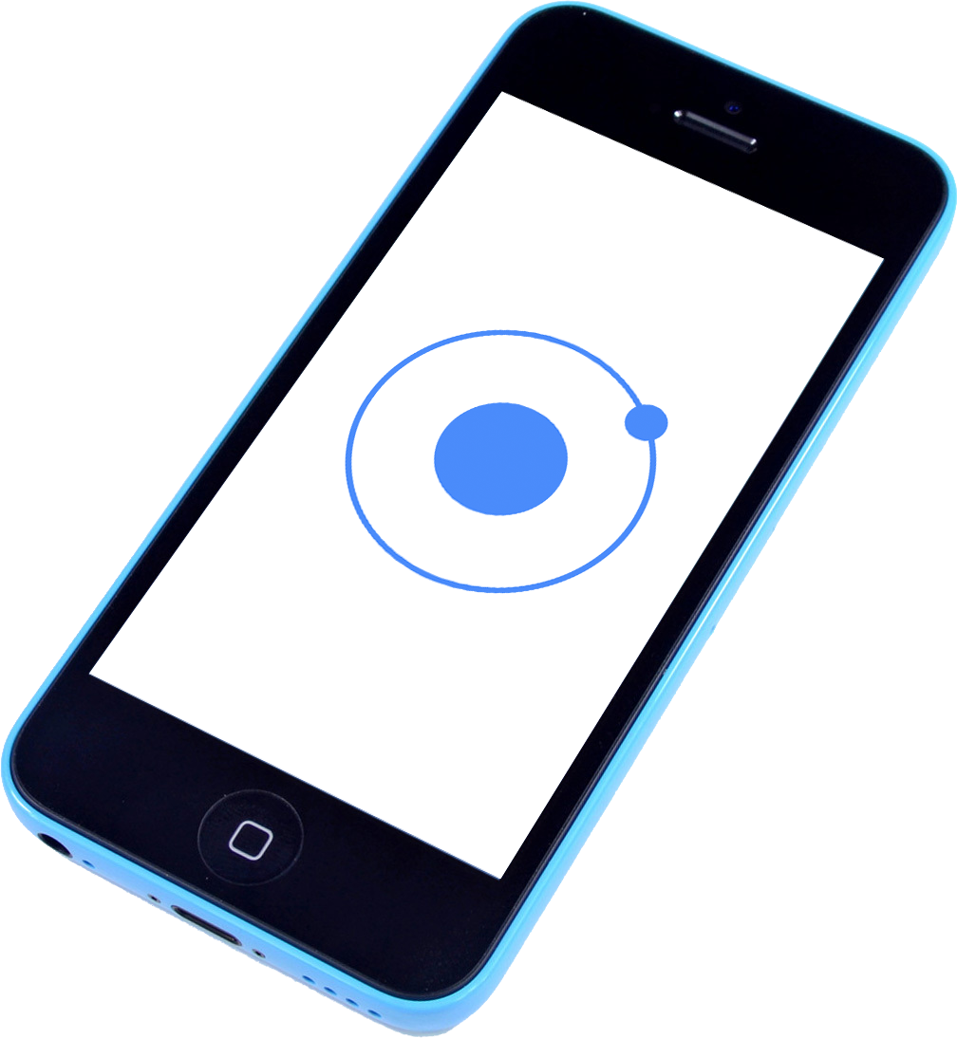
Ionic In Action
(What’s In The Box?)
©2015 Milk Can LLC

Slide 16
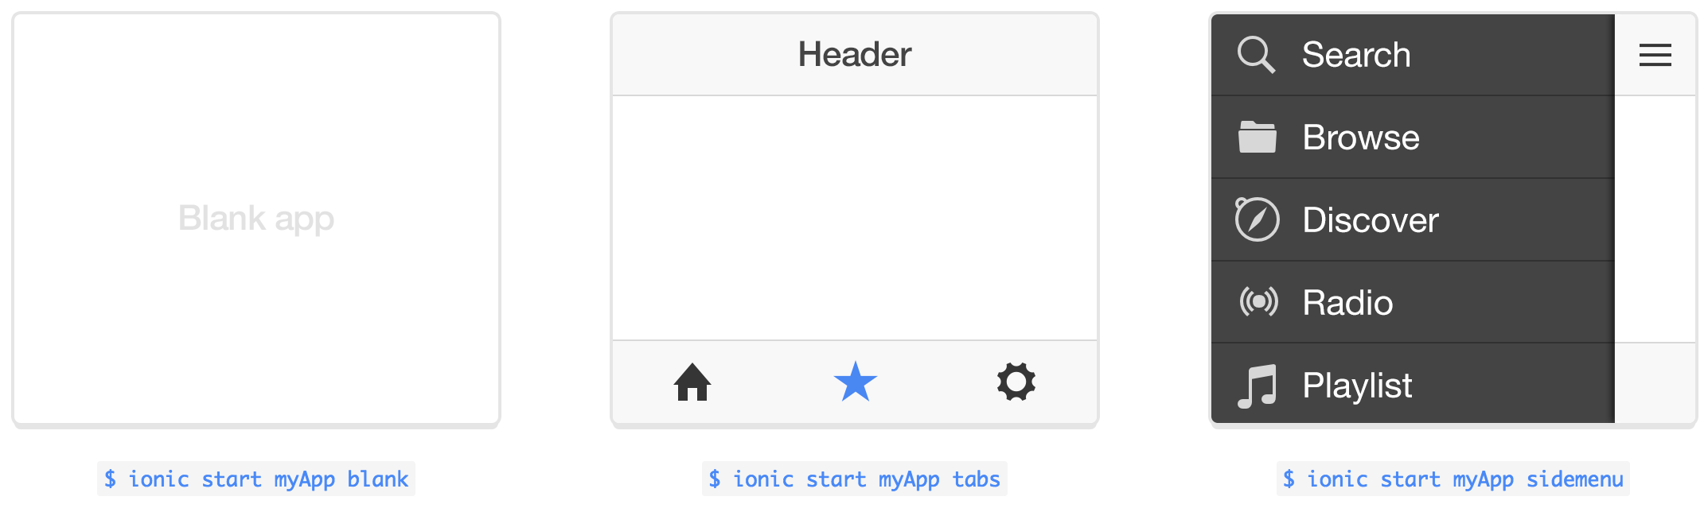
Ionic Start
$ ionic start myApp blank
$ ionic start myApp tabs
$ ionic start myApp sidemenu
Start your application with a blank slide, or fully functional navigation.
Find more templates on GitHub. Good resource:
http://ionicframework.com/docs/cli/start.html
©2015 Milk Can LLC

Slide 17
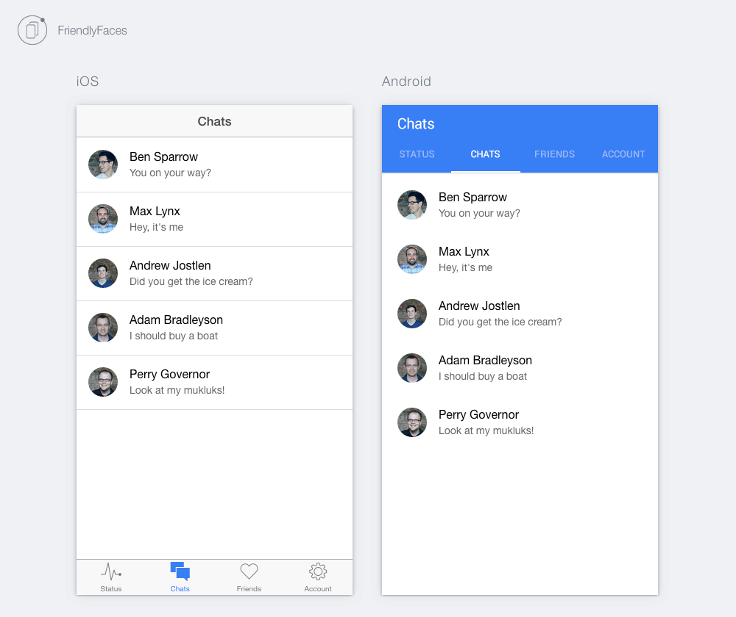

Ionic Lab
$ ionic serve --lab
View your changes instantly with both Android and iOS views.
©2015 Milk Can LLC

Slide 18

Ionic LiveReload
$ ionic emulate ios --livereload --consolelogs --serverlogs
$ ionic run android -l -c -s
Run or Emulates on your device(s) with live updating
Great for testing
©2015 Milk Can LLC

Slide 19
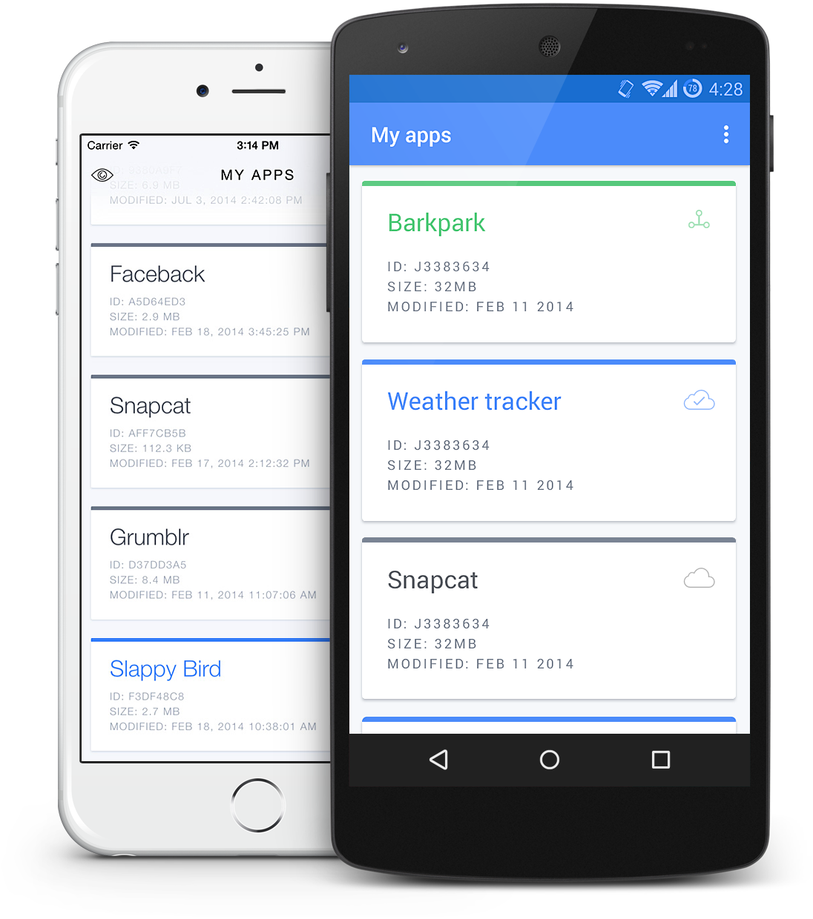
Ionic ViewApp
Push app to user devices without waiting for the stores.
Allows testers to reset app data and exit the app whenever they need.
Only basic level of plugin support.
©2015 Milk Can LLC

Slide 20
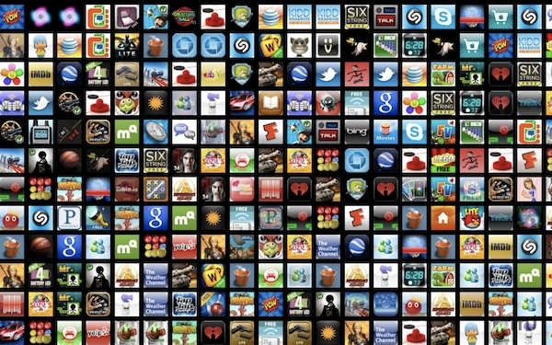
Ionic Resources
$ ionic resources
$ ionic resources --icon
$ ionic resources --splash
Create all of your icons and splash screens from single source
Splash Screen: 2208px x 2208px
Icon: 192px x 192px
©2015 Milk Can LLC

Slide 21
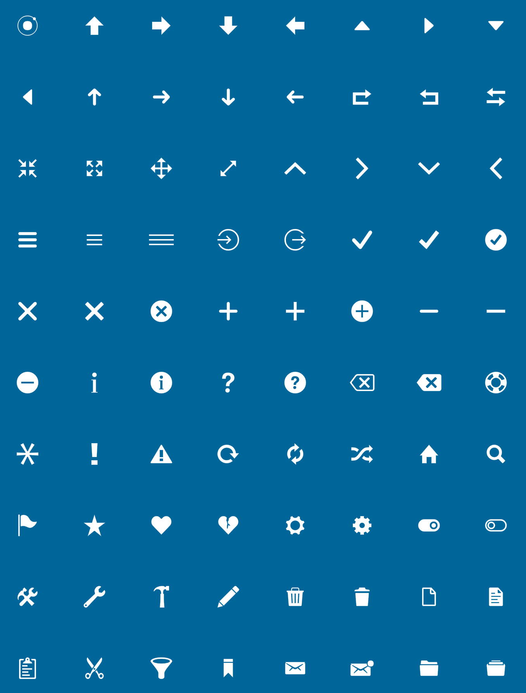
Ionicons
700+ Font Icons for mobile that are all 100% Free and Open Source. MIT Licensed.
©2015 Milk Can LLC

Slide 22
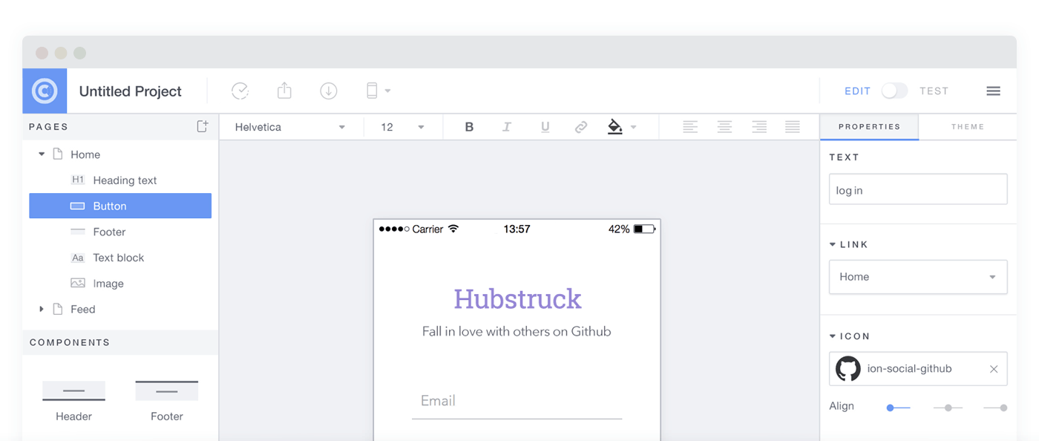
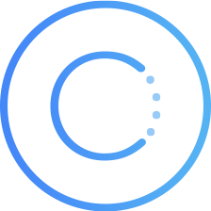
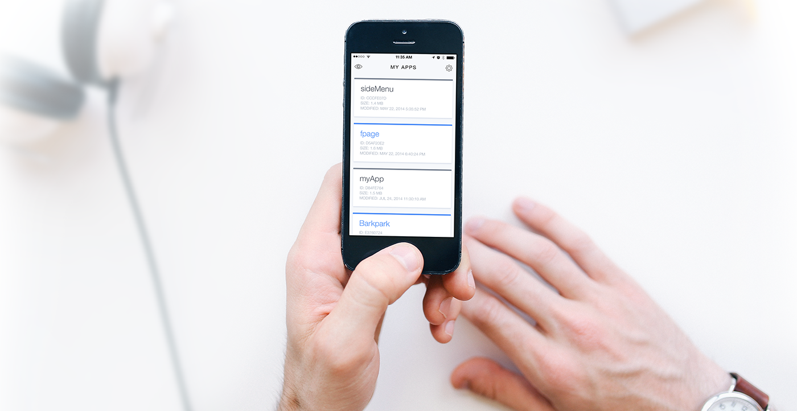
Ionic Creator
Recently Updated to Version 1.1
GUI Interface for Creating App
Easy to Share
Exports Production Ready Code
https://creator.ionic.io/app/login
©2015 Milk Can LLC

Slide 23
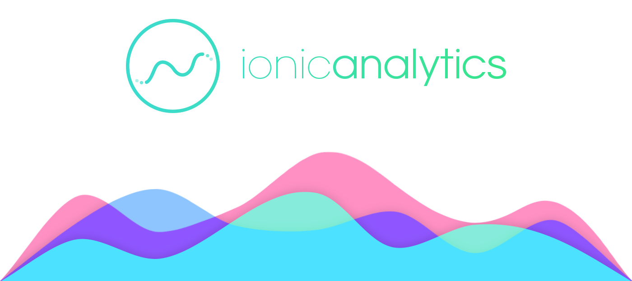
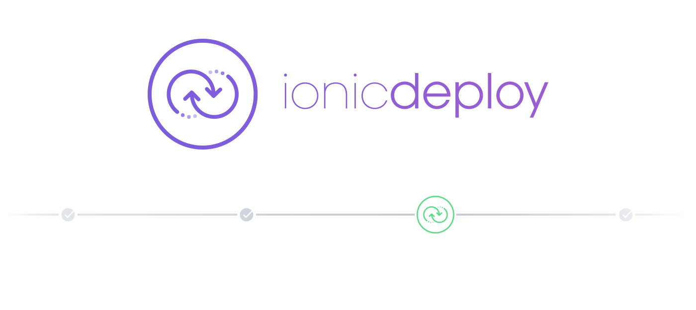
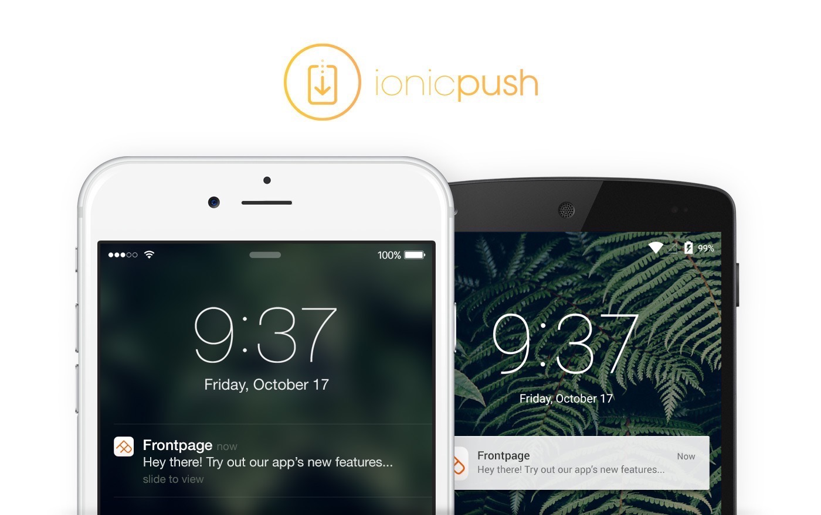

More All The Time….
©2015 Milk Can LLC

Slide 24
More Ionic
Getting Started Guide
ionicframework.com/getting-started
Documentation
ionicframework.com/docs
Ionic Community
FORUMS: forum.ionicframework.com
SLACK: ionic-worldwide.slack.com
Meet Ups
MADISON: meetup.com/Ionic-Madison/
Contribute on GitHub
github.com/driftyco/ionic
©2015 Milk Can LLC

Slide 25
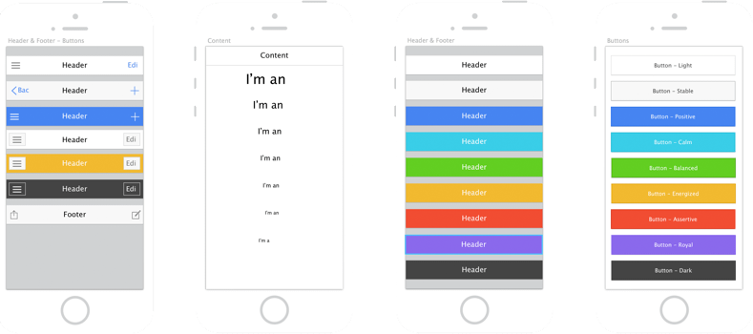
Ionic Components
(Let’s Build An App)
©2015 Milk Can LLC

Slide 26

Thank You!!! Questions???
You can access this presentation and app code here
https://github.com/milkcan/2015-MKE-CODECAMP
Matthew Ridley
@matt_ridley
matt@milkcan.io
©2015 Milk Can LLC

